Slide 1

MOBILE APPLICATION Development (114115)
Dr. Owais Hussain

Slide 2

Agenda
History
Differences from desktop/web application
Modern platforms, languages and tools
Types of Mobile App development

Slide 3
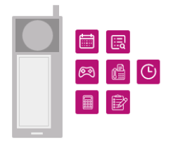

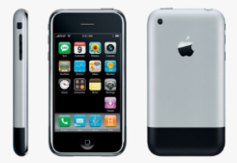
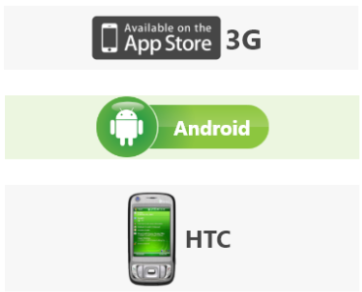
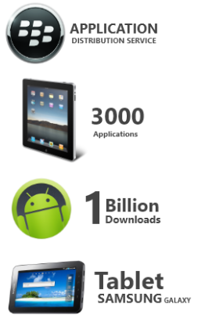
Brief history of smart Mobile devices
1993: IBM introduces SIMON. Touchscreen + Utilities and Games
2002: RIM releases Blackberry with Wireless email
2007: Apple unveils iPhone with suite of smart apps including Maps, Photos, Weather, etc.
2008: Apple launches AppStore; Google joins the club with first linux-based Android phone
2010: Blackberry World is released; Apple launches iPad with 3000 apps on AppStore; Android reaches 1Billion downloads; Samsung enters the market with its flagship Galaxy series
Notes:
Evolution of Mobile Applications: 1993-2020 (appverticals.com)

Slide 4

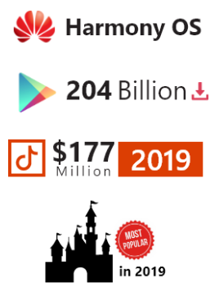



Brief history of smart Mobile devices
2012: things begin to scale to millions & billions
2019:
Huawei releases Harmony OS
App Stores record 204B downloads
TikTok grosses to $177M
Disney becomes 2nd most popular app
Amazon, Samsung, and more companies have own independent app stores
2020 to date:
5G and Internet of Things
Blockchain
AR, VR, AI
GAMING INDUSTRY
Notes:
Evolution of Mobile Applications: 1993-2020 (appverticals.com)

Slide 5

Sample 2
Differences from Desktop/Web Applications
Broad range of hardware
OS-level compatibility needs
Limitations
Processing power
Memory/Storage
Human-interfacing
Several input channels
Offline function
Lack of User training

Slide 6
Sample 2
Differences from Desktop/Web Applications
Relatively new field with lack of standardization
Mobile Platforms have their own set of tools and frameworks
Cumbersome Testing and Quality Assurance
Rapid changes in the industry

Slide 7

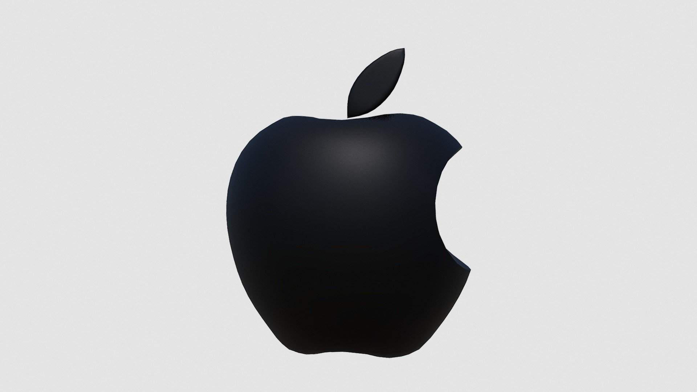

Sample 2
Modern Platforms, Languages, and Tools
Android
Java/Kotlin
Android Studio
iOS
Swift
Xcode/Appcode
Win UI (.NET)
C#
Visual Studio (Code)

Slide 8
Sample 2
Types of Mobile App development
NATIVE
All native features available
Highly compatible across devices
High development and maintenance cost
HYBRID
Limited native features available
Web browser as base App
Highly dependent on internet
Low development cost
CROSS-PLATFORM
Most of native features available
Can work offline

Slide 9
Sample 2
Unofficial Quiz
Can you answer the following questions?
Why aren’t we learning Android or iOS app development?
What 3 major aspects make mobile app development challenging?
Why React Native, when there are more recent and promising options available?
What guarantees that React Native will stay for long in the mobile app industry?

Slide 10



THANK YOU
Owais Hussain
+92 345-3174270
owais.hussain@kiet.edu.pk
https://www.researchgate.net/profile/Owais-Hussain-3

